Slide 1
Data visualization
Taylor Dunivin
EDAMAME
July 26, 2018

Slide 2
Why R?
free
open-source
designed for data analysis and statistics
user-community
highly extensible
easy organization with RStudio

Slide 3
R community
www.r-bloggers.com
Twitter
@hadleywickham
@rstudiotips
Stack overflow: https://stackoverflow.com/tags/r/info

Slide 4
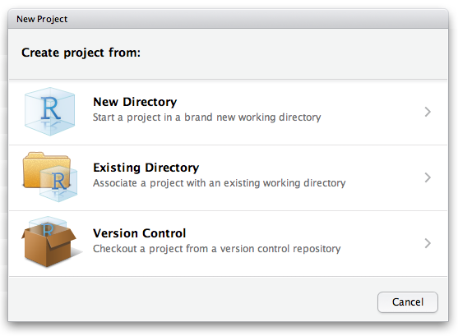
Organization in Rstudio (Projects)
File → New Project

Slide 5
Organization in Rstudio (Projects)
File → New Project
What’s included in an R Project?
.Rproj extension
Self-contained home for
code
data
output
figures
.gitignore
Working directory = project directory

Slide 6
RStudio
Notes:
https://support.rstudio.com/hc/en-us/articles/200532077?version=1.0.143&mode=desktop

Slide 7
Console vs. script
SCRIPT
Preserve work in a plain-text file (.R extension)
Do your work here, and save this to be able to reproduce or edit it at a later date
CONSOLE
Yame as typing R in your command line
You can type in commands and R will execute them and print the result
Pro tip: cmd/ctrl-enter executes the line the cursor is on by copying that line and sending it to the Console
Notes:
Mixes interactivity and preservation
Save just text and can get same results at another time or on another machine
Building preservable pipeline of operations

Slide 8
Special features
ignoring whitespace
tab completion
objects
packages
assignment within a function
consistent documentation/ help files
?function
??anything
R is chatty
error messages
warning messages

